Slide 1
Deep Learning for Recommender Systems: An Applied Approach
Deep Learning for Recommender Systems
Why do we need it?
Deep Learning Models for Recommender Systems
Building Deep Learning Based Recommender Systems
Shahzaib Hamid

Slide 2
Overview
Overview of Deep Learning in Recommendation Systems
Benefits and Challenges of Deep Learning in Recommender Systems
Deep Learning for Recommendation Inference
A Generic Deep Learning based Recommendation Approach
Neutral Collaborative Filtering
Variational Autoencoder for Collaborative Filtering
Hand on Practice on Deep Learning based Recommender System Development (Next Module)

Slide 3
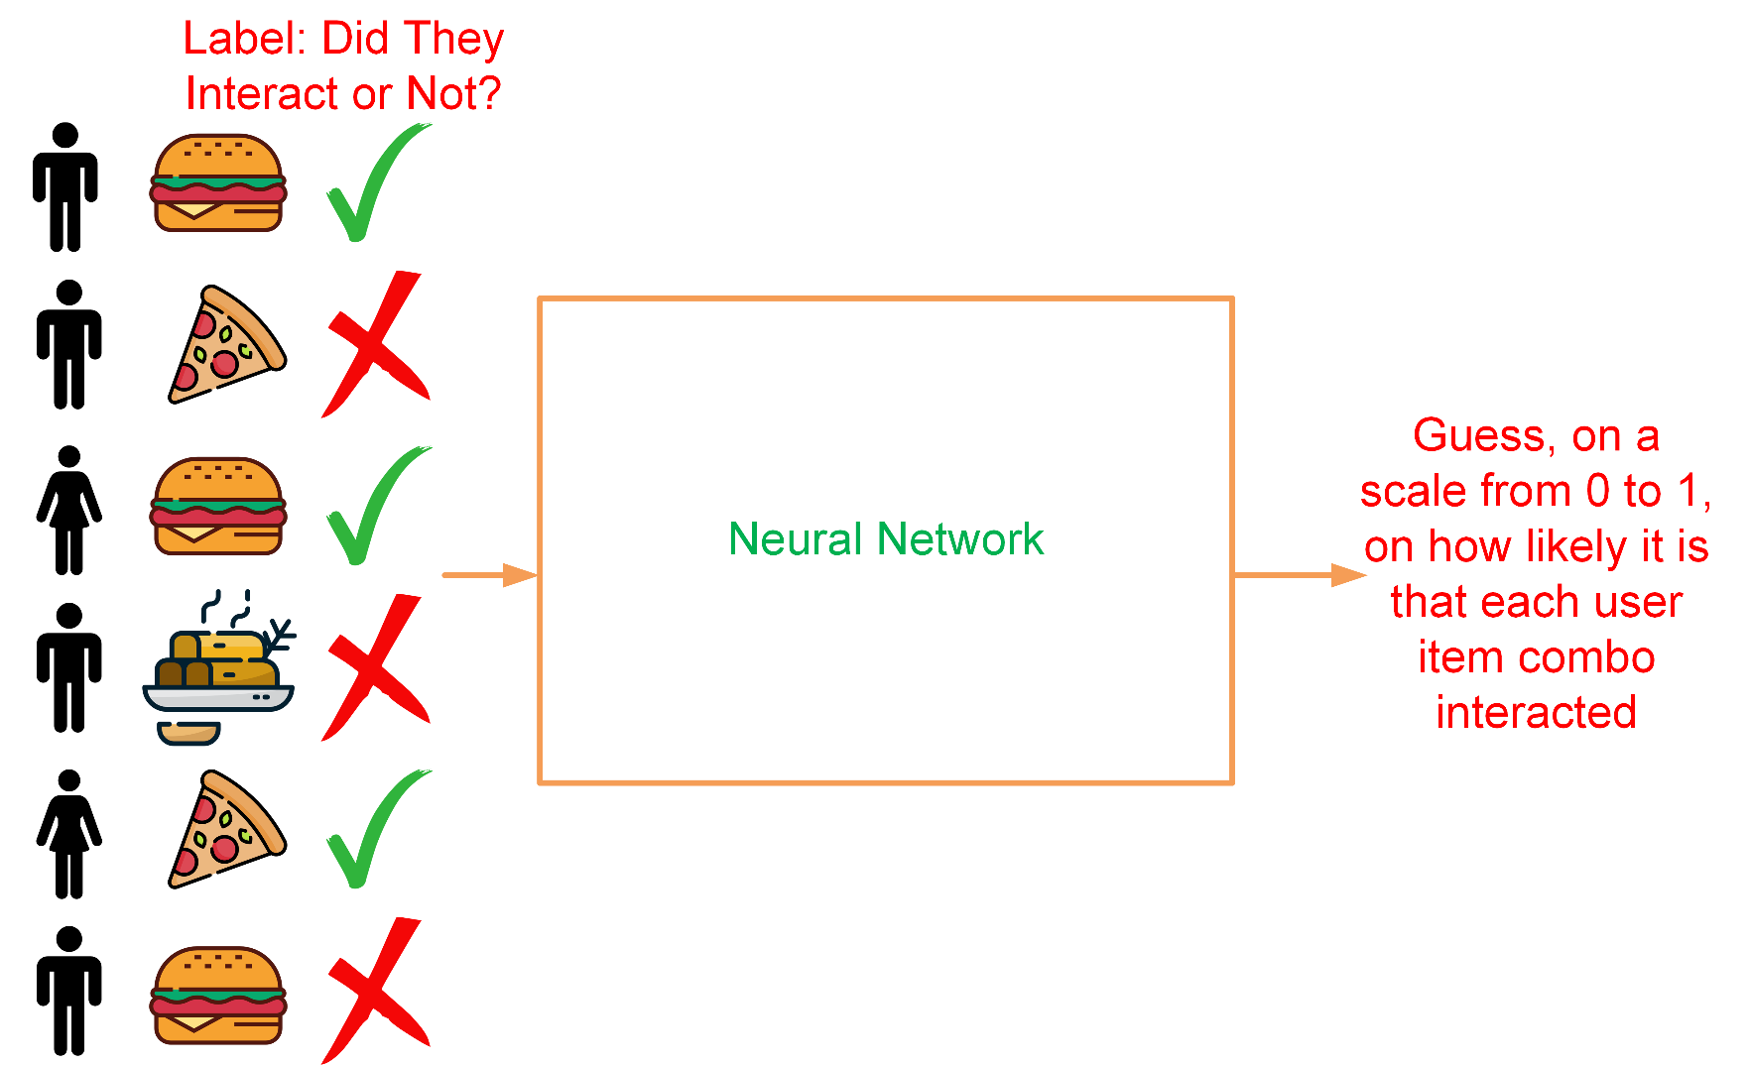
Deep Learning in Recommendation Systems
Recommender systems are migrating from ML to DL
Captures non-linear and non-trivial relationship
Notes:
Due to increased number of data
Captures non-linear and non-trivial relationship between user and product

Slide 4
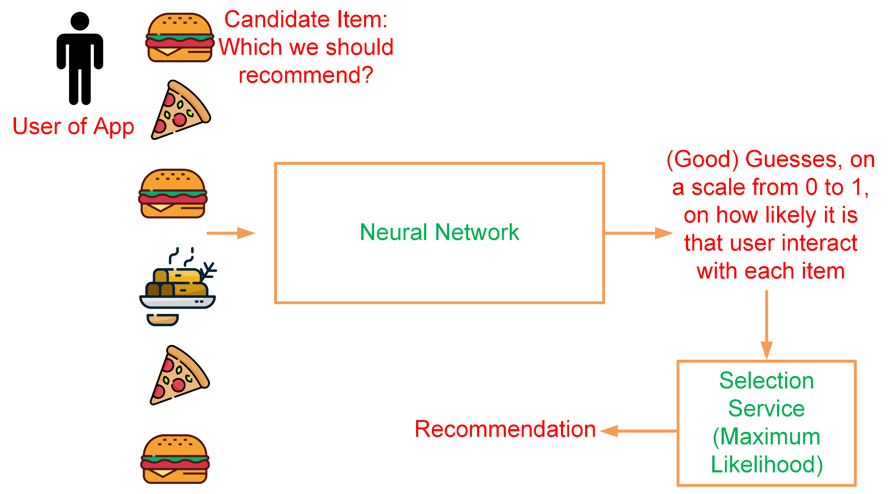
Deep Learning for Recommendation Inference

Slide 5
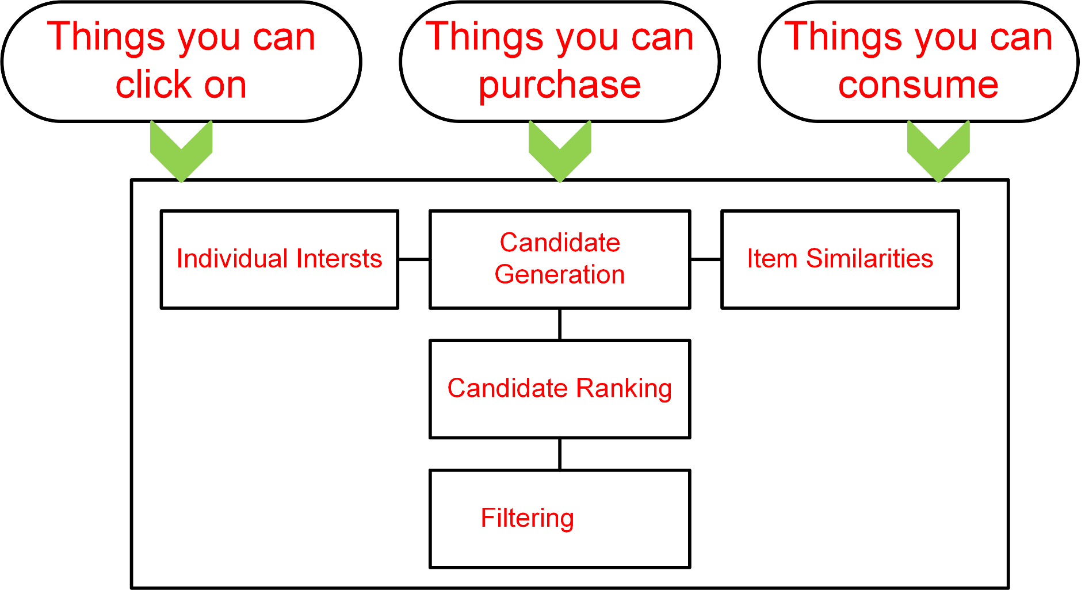
Generic Recommendation Systems Inference Mechanism

Slide 6
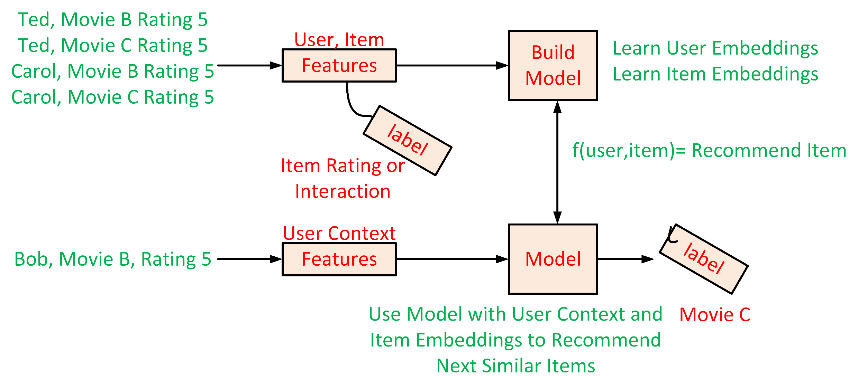
Deep Neural Network Models for Recommendation

Slide 7
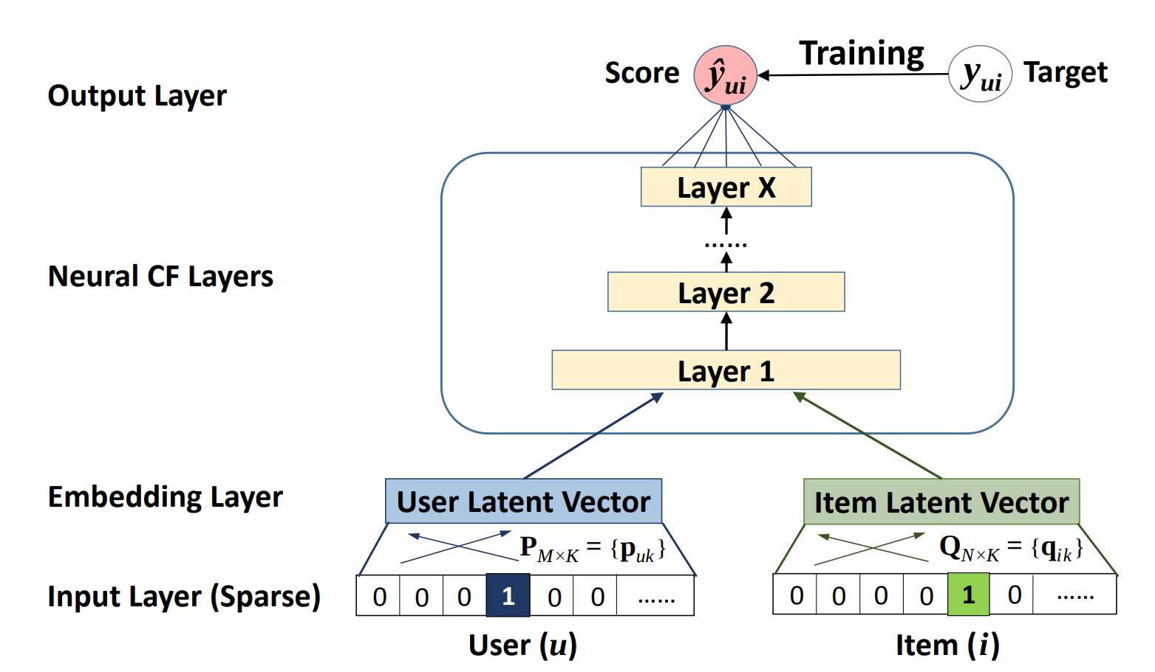
Neutral Collaborative Filtering
Xiangnan He, Lizi Liao, Hanwang Zhang, Liqiang Nie, Xia Hu, and Tat-Seng Chua. 2017. Neural Collaborative Filtering. In Proceedings of the 26th International Conference on World Wide Web (WWW '17). International World Wide Web Conferences Steering Committee, Republic and Canton of Geneva, CHE, 173–182.

Slide 8
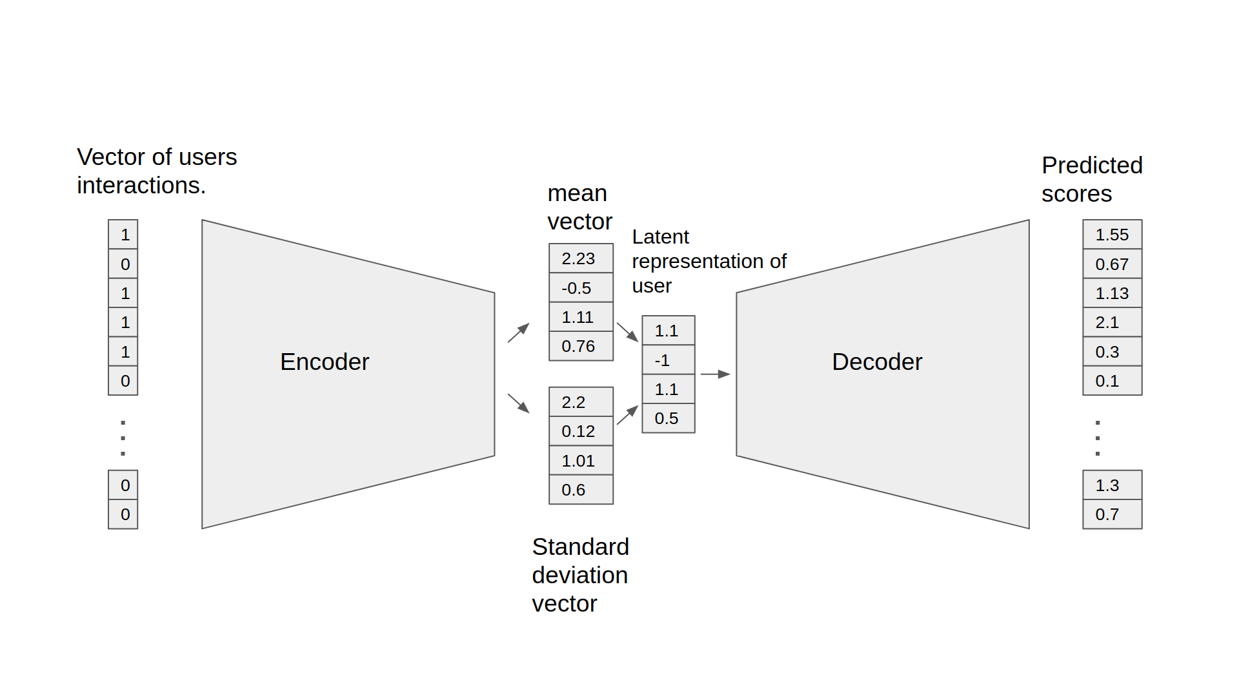
Variational Autoencoder for Collaborative Filtering
Liang, Dawen, Rahul G. Krishnan, Matthew D. Hoffman, and Tony Jebara. "Variational autoencoders for collaborative filtering." In Proceedings of the 2018 world wide web conference, pp. 689-698. 2018.

Slide 9
Strengths of Deep Learning in Recommendation Systems
Non-Linear Transformation
Representation Learning
Sequence Modelling
Flexibility

Slide 10
Limitations of Deep Learning in Recommendation Systems
Extensive Hyper Parameter Tuning
Data Requirement
Interpretability

